Slide 1
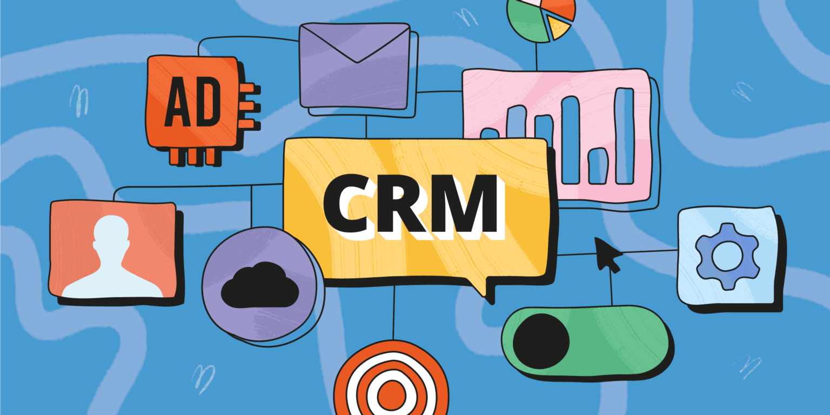
CSYE 6225-Final Project: Customer-Relationship-Management

Slide 2


CRM Team
Ashitha Reez
Neha Gopinath

Slide 3
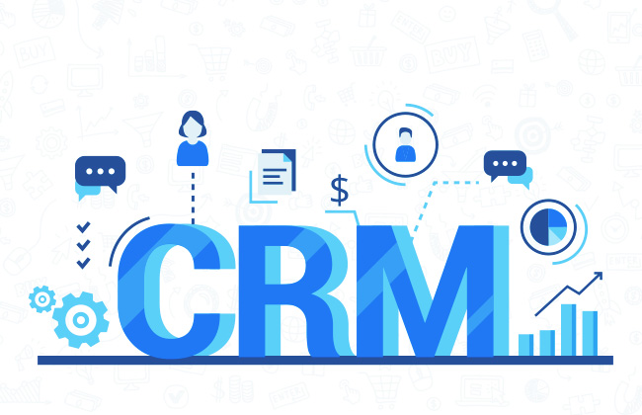
Table of Content
Meet the team
About
Architecture
Features
Tech Stack
AWS Services Used
Timeline
Difficulties
Overcame
Lesson Learned
Trello Board
Screenshots

Slide 4
About
The project focuses on developing a cloud-based CRM web application hosted on AWS to streamline customer data management and enhance efficiency. This system will help users manage customer information, track sales, and maintain communication logs. It will feature interactive pages, including a dashboard and a customer management page. A robust Microsoft Azure database backend will ensure reliable and scalable data storage. Leveraging AWS services, the project aims to deliver a secure, high-performing, and accessible CRM solution for businesses.

Slide 5
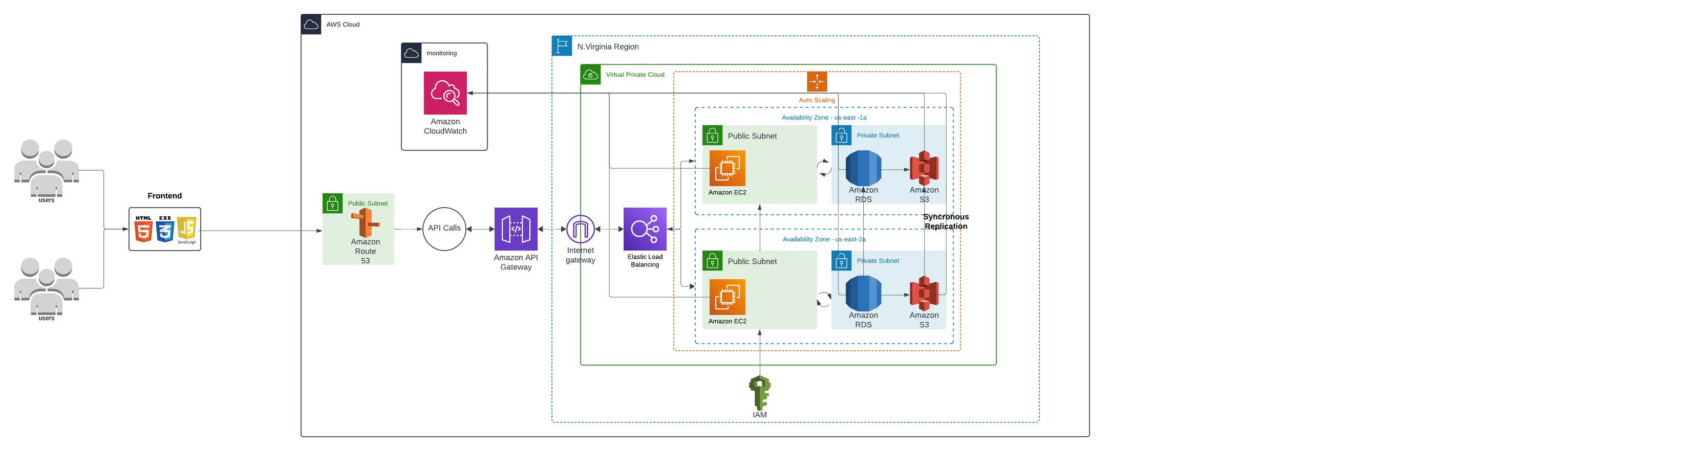
Cloud Architecture

Slide 6
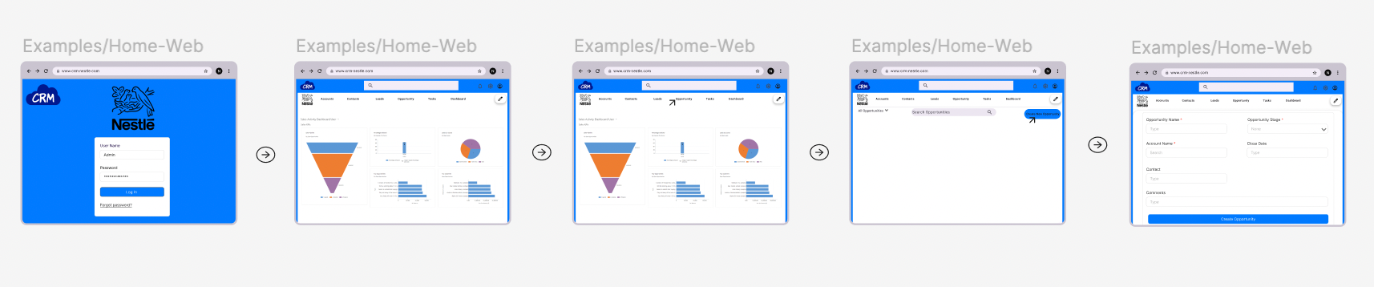
Design blueprint - Figma

Slide 7

CRM
CRM Features
Feature 05
Feature 01
Login and Logout
Creation Page for Lead, Account, Contact and Opportunity
05
01
Feature 04
Edit and Save option for
Detail Page
Feature 02
04
02
Data List Page for Lead, Account, Contact and Opportuntiy
03
Feature 03
Detail Page for Lead, Account, Contact and Opportunity

Slide 8







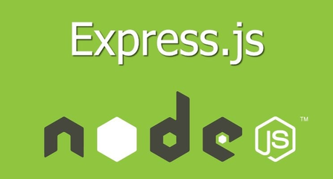
Tech Stacks Used

Slide 9
AWS Services Used
Amazon API Gateway – To manage API calls from users.
Elastic Load Balancing (ELB) – For distributing incoming traffic across multiple Amazon EC2 instances.
Amazon EC2 – Virtual server instances for application hosting.
Amazon S3 – For object storage and synchronous replication.
Amazon CloudWatch – For monitoring and logging.
Internet Gateway – To enable communication between your VPC and the internet.
Virtual Private Cloud (VPC) – To isolate the network infrastructure.
IAM (Identity and Access Management) - is for secure access and permission management.
Auto Scaling – To automatically scale the EC2 instances based on demand.
These services are spread across multiple Availability Zones within the N. Virginia Region for high availability and redundancy.
Microsoft SQL Azure – Managed relational database service.

Slide 10
Timeline
Sprint Planning Sessions, Scrum Meetings and Closing all the user stories in sprint. Planning for the next Sprint
Presentation & Project Submission
Architecture Diagram & Scrum Board Setup
Milestone9
Team Agreement
Milestone4&8
Idea Presentation and vote for the favourite idea
Milestone3
Milestone2
Milestone1

Slide 11
Challenges Faced & Solutions
Issues with GitHub
Issues with fetching data from the database
Deployment to cloud
Effective communication
Regular code reviews and testing
Online resources
Work in coordination
Peers shared best practices for resolving conflicts and improving commits.

Slide 12
Lesson Learned
Enhanced skills in dividing and assigning tasks effectively among team members to ensure smooth progress.
Gained hands-on experience in setting up and managing a database, and ensuring seamless integration with back-end APIs.
Learned to deploy applications on the cloud using AWS services.
Acquired valuable knowledge about web application development, cloud architecture, and the interplay of front-end and back-end technologies.

Slide 13
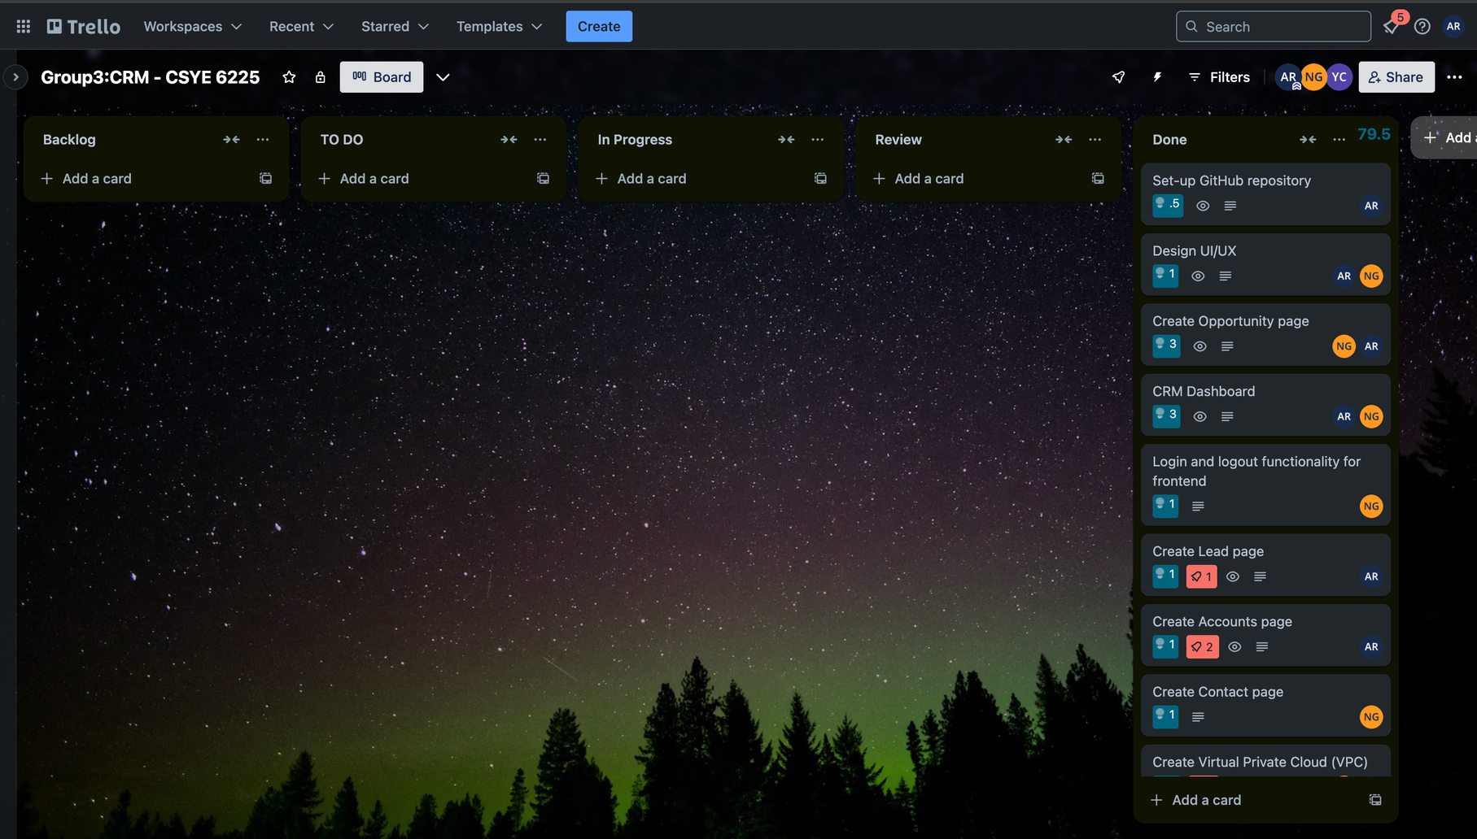
Trello Board

Slide 14
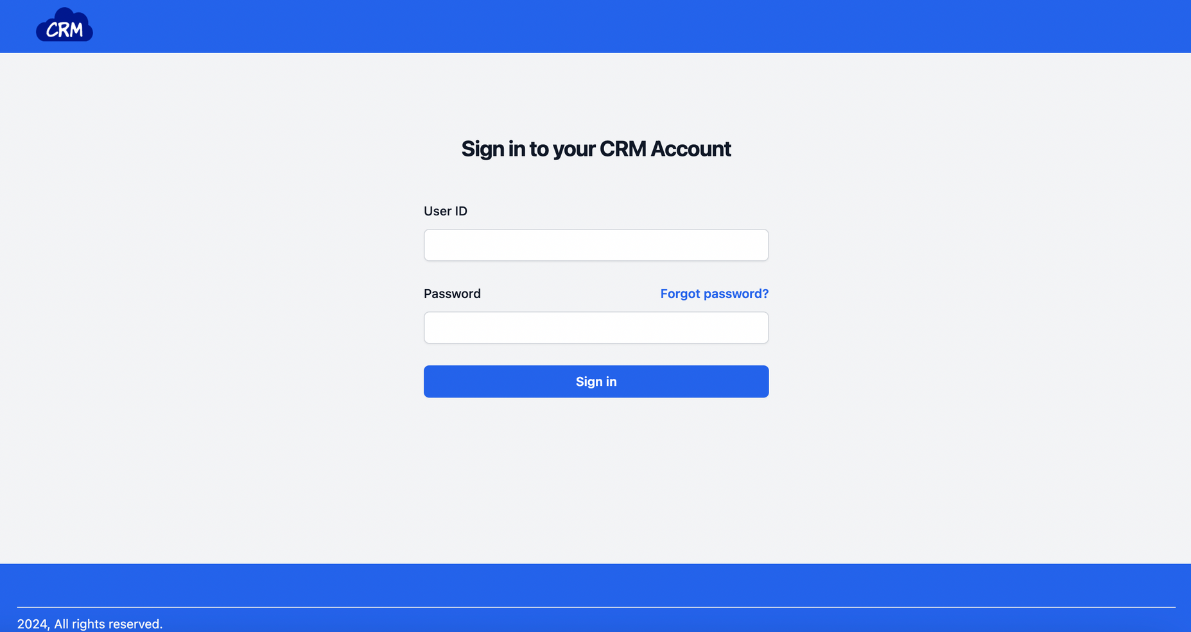
ScreenShots of the CRM Application

Slide 15
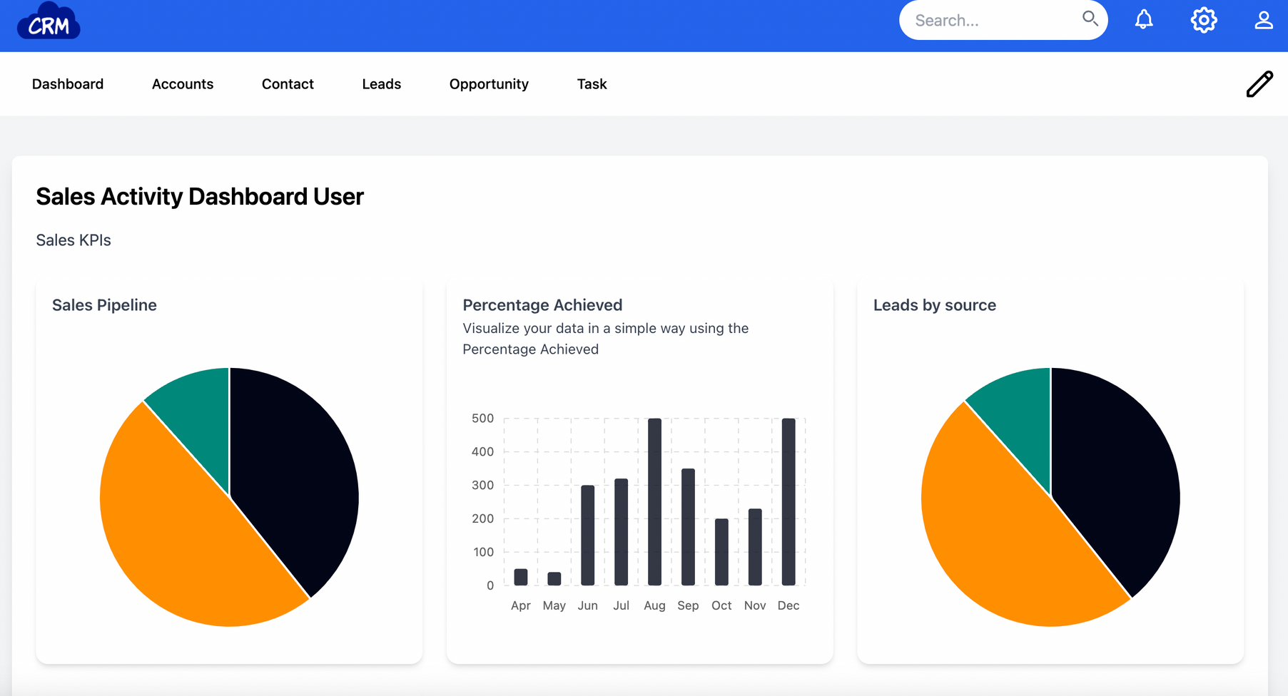
ScreenShots of the CRM Application

Slide 16
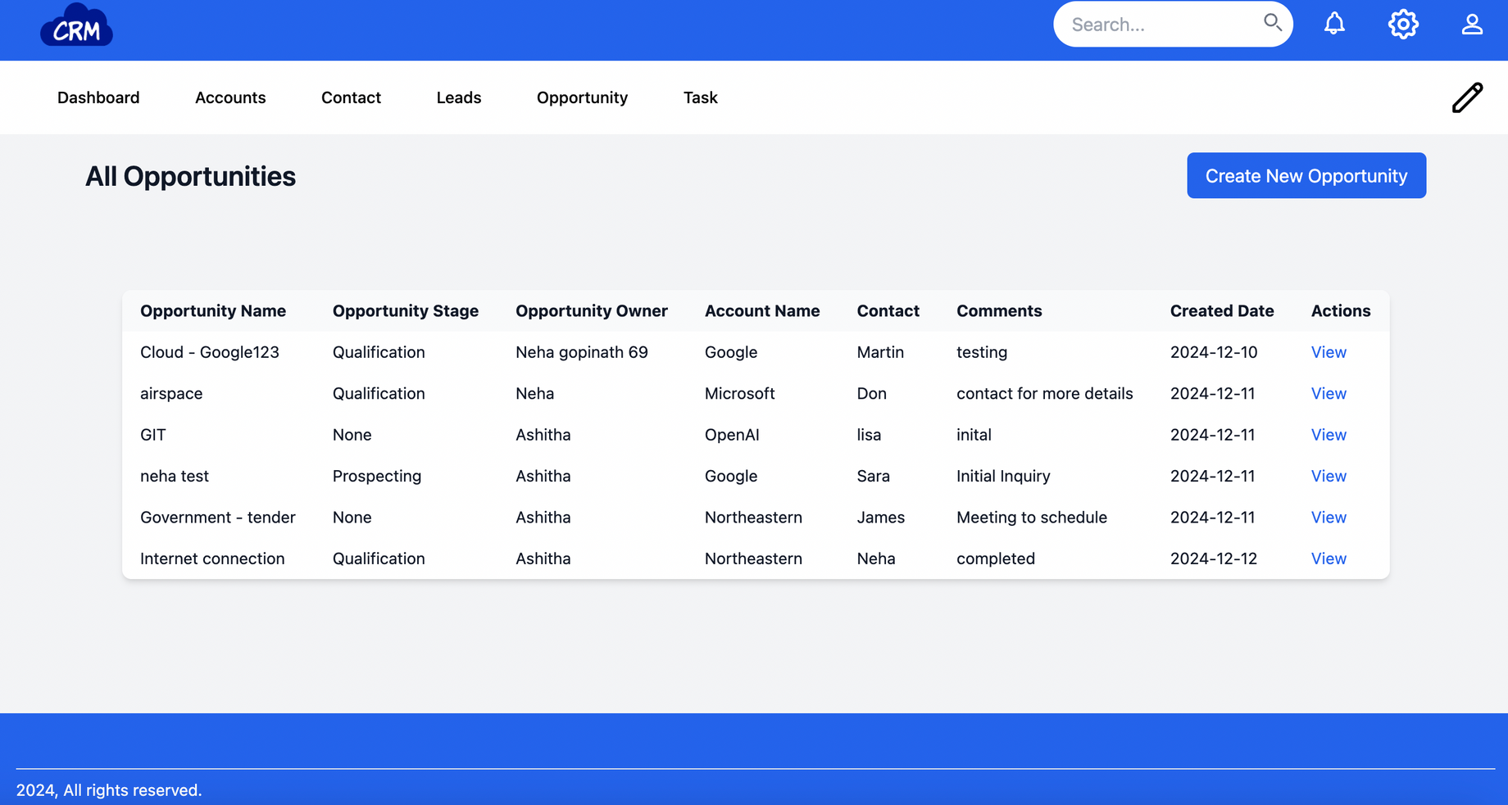
ScreenShots of the CRM Application

Slide 17
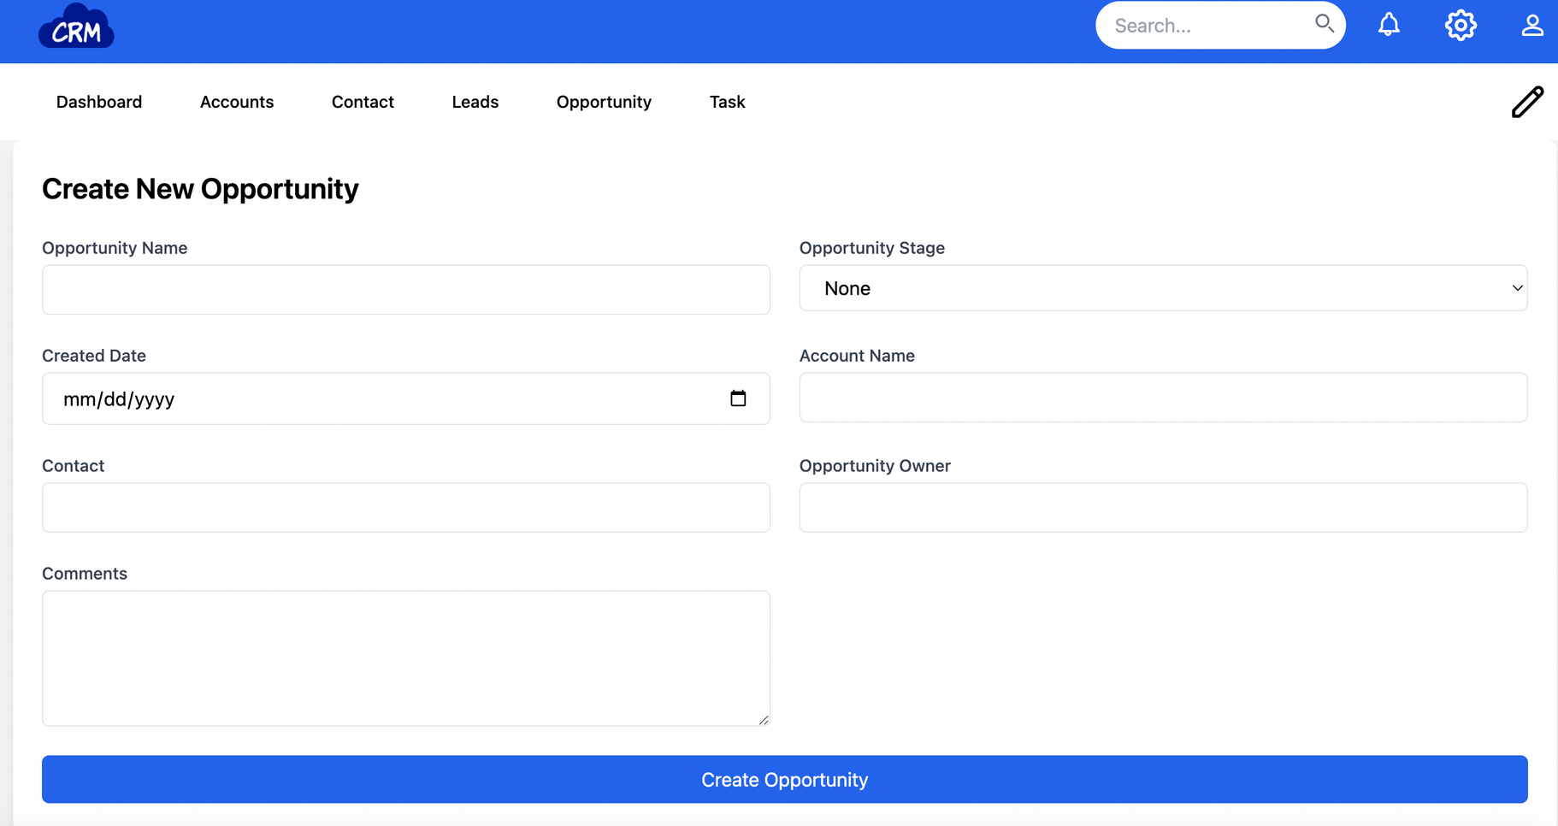
ScreenShots of the CRM Application

Slide 18
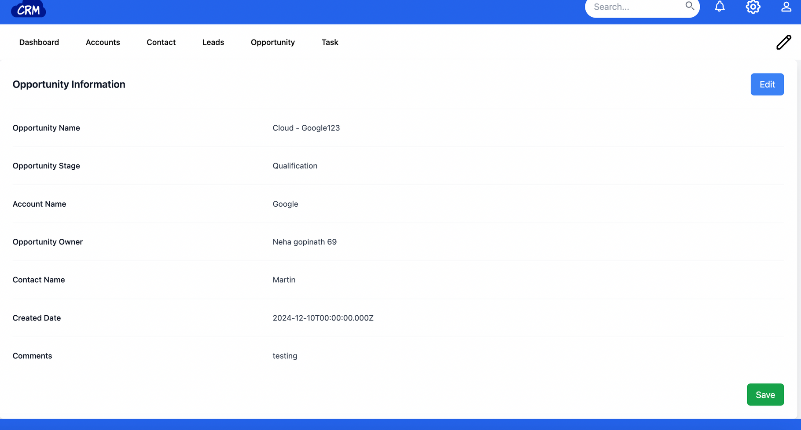
ScreenShots of the CRM Application

Slide 19
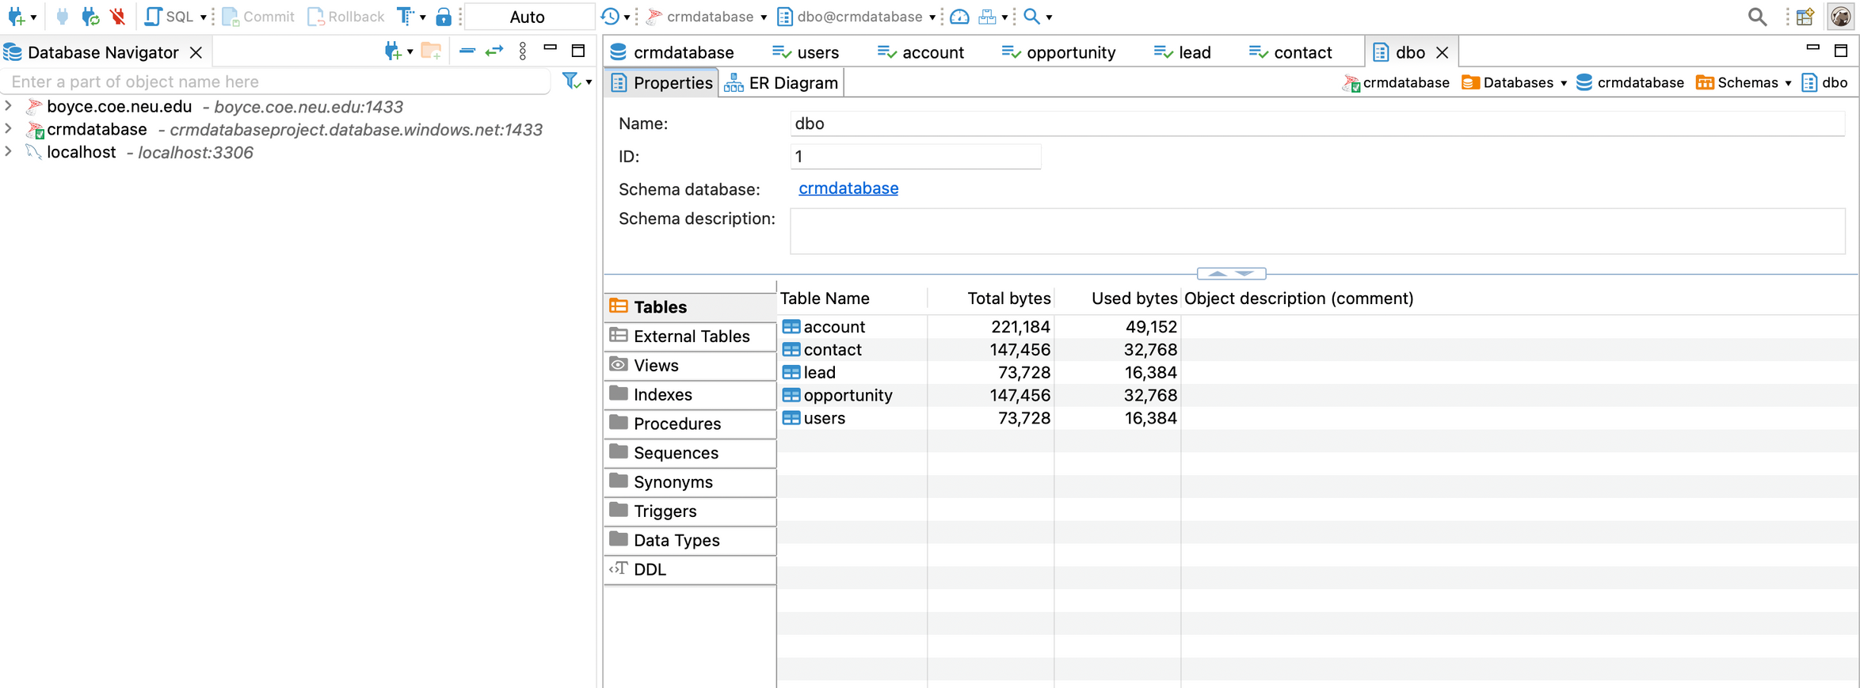
Database Screenshot

Slide 20
Thank you

